Slide 1
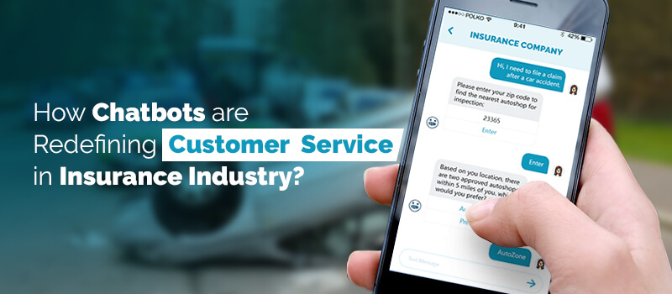
INSURANCE CHATBOT
Using RASA
Presented By:
Arpit Rathore
Harman Bhutani
Rahul Sharma

Slide 2

Agenda:
What is Chatbot and its importance in business
Business understanding
Data Understanding
Data Preparation
Modeling
Evaluation
Deployment/Demo

Slide 3
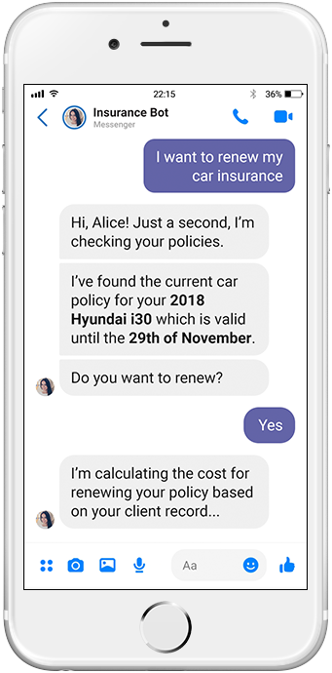
Chatbot Introduction
The aim of a chatbot is to make communicating between humans and machines as simple as possible by using predefined steps.
Virtual assistants, also known as chatbots, are the most common technology on the market right now, and we can find them on almost any website and mobile device.

Slide 4
Importance of Chatbot
Chatbots are valuable because they have a new means of interacting with end users and improve both the user interface and response time
85% of customer interactions will be managed without a human by 2021 - as per studies
10k+ developers are building chatbots in Facebook Messenger - Facebook
Chatbots can help boost the always accessible customer service operation

Slide 5
Type of Chatbots
Keyword Recognition-based Chatbots : These chatbots use customised keywords and AI to figure out how to react to the user in the most suitable way
Contextual Chatbots : This chatbots use machine learning and artificial intelligence to recall interactions with real users in order to learn and evolve over time like Siri
Menu/Button - Based Chatbots : This Chatbots are essentially glorified decision tree hierarchies that are shown to the user as buttons

Slide 6
Business Understanding

Slide 7
Why Insurance Chatbot?
Millennials make a big piece of the potential-customer-pie
Insurance companies involves repetitive, time-consuming, and lengthy questionnaires
Customers want insurance providers to communicate with them on a regular basis
Customers find the fine print of insurance lengthy, arcane and almost intimidating

Slide 8
Insurance Chatbot Benefits
24/7 customer support
More efficiency in utilizing time
Easy deployment and ICP overview
End to end Integrations
Analysis and key insights
Notes:
Benefits of using Chatbots for Insurance
24/7 Support
Your prospects will always be greeted with a dedicated 24/7, mobile-optimized, personal assistant taking care of their insurance-related needs through clear communication.
More Efficiency
By address almost all the mundane and time-consuming jobs, the bots can help the employees utilize their time more efficiently as well as reduce overall staffing, onboarding, and training costs.
Easy Deployment & ICP Overview
These bots can be deployed on any of the channels your customers are using on a daily basis, be it a website or Messenger or WhatsApp or even SMS. A record of the interactions with individual customers can help the marketing and sales team get a complete overview of their ideal customer profile. This organized profiling can help you design contextually relevant and highly personalized marketing campaigns.
End to End Integrations
With the bot tightly coupled with your internal systems, you don’t have to worry about changing how you work or looking at disparate sources of data. The chatbot can be integrated with your internal CRMs or databases along with tools such as Health Sherpa, CompuLife, Ninja Quoter, eHealth, and more.
You can take a look at the complete set of chatbot integrations here – https://wotnot.io/integrations/
Analysis & Key Insights
You can monitor the overall performance via chatbot analytics and figure out what is working and what is not. Unlock insights from data to create the right AI-powered conversational experiences for customer service. Continually analyzes and optimizes virtual agents or any other conversational experience (whether voice or text), uncovering gaps, and suggesting fixes.

Slide 9
What is RASA?
RASA is a chatbot solution and a conversational AI framework
Open-source, ML framework for automated text and voice based conversation
Transparent, which means we know exactly what is happening under the hood and can customize things as much as we want
It is one of the most effective and time efficient tools to build complex chatbots in minutes

Slide 10
Why we choose RASA?
Easy to integrate and customize
No state machine
Integrate into existing systems
Support various intent
Interactive Learning
Connect with other messaging apps
Multiple deployment environment
Role-based access control

Slide 11
Data Understanding

Slide 12
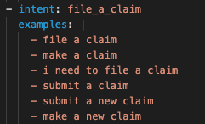
Data Understanding
Some important concepts :-
• Intent: Consider it as the aim or target of the user input. If a user say, "I want to make a claim", Or "I would like to know quote for health insurance". Here, the intent would be "Claim" and “Quote of Claim”.
• The Verbs in your dialog.
• The action a user wants to take that they expect your chatbot to fulfil or facilitate.

Slide 13
Entity- • Consider it as the useful information from the user input that can be extracted.
From previous example, "I want to order a book". If we extract "boor as the entity, we can perform the action on book. The nouns in your dialog.
Another example: "Reserve a table at Taj Hotel tomorrow night" Entity would be, place and time.

Slide 14
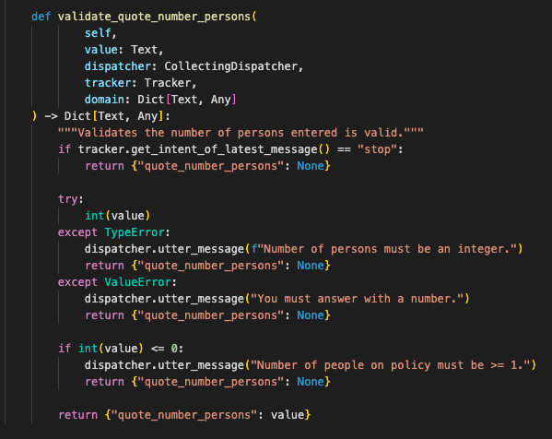
• Actions: It could be replying something in return, querying a database or any other thing possible by code.

Slide 15
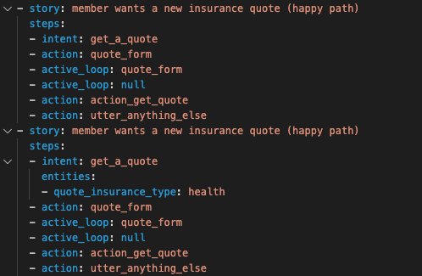
• Stories: These are a sample interaction between the user and bot, defined in terms of Intents captured and actions performed.

Slide 16
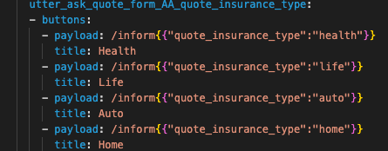
Domain - Domain Knowledge is required to reply to any user input based on intents , entities and actions.

Slide 17
Data Preparation

Slide 18
Defining all these concepts in our code :-
Intent & Entity ->nlu.yml
Story(Dialogue management) -> stories.yml
Actual Output -> domain.yml
Custom reply -> actions.py

Slide 19
Data Modeling

Slide 20
Important tools in data modeling
• Rasa NLU:
A library for NLU which takes the user input and tries to Infer the intent and extract the available entitles and helps the Bot to understand what user is trying to say.
Example: "I want to make a claim of my health insurance of 2000$"
Intent - make_claim, Entities - (Type_claim - Health , Amount - 2000$)
Main job of NLU:-
Training data format
Language support
Choosing a pipeline
Entity Extraction

Slide 21
• Rasa Core:
A dialog management ML based solution, which takes the structure input from the NLU tries to build a probability model which decides the set of actions to perform based on the previous set of user inputs.
Main jobs of Rasa Core
dialogue engine
Stories
Domain
Response
Action

Slide 22
The steps are:
• The message is received and passed to an Interpreter, which converts it into a dictionary including the original text, the intent, and any entity that were found. This part is handled by NLU.
The Tracker is the object which keeps track of conversation state. It receives the info that a new message has come in.
• The policy receives the current state of the tracker The policy chooses which action to take next.
• The chosen action is logged by the tracker.
• A response is sent to the user.

Slide 23
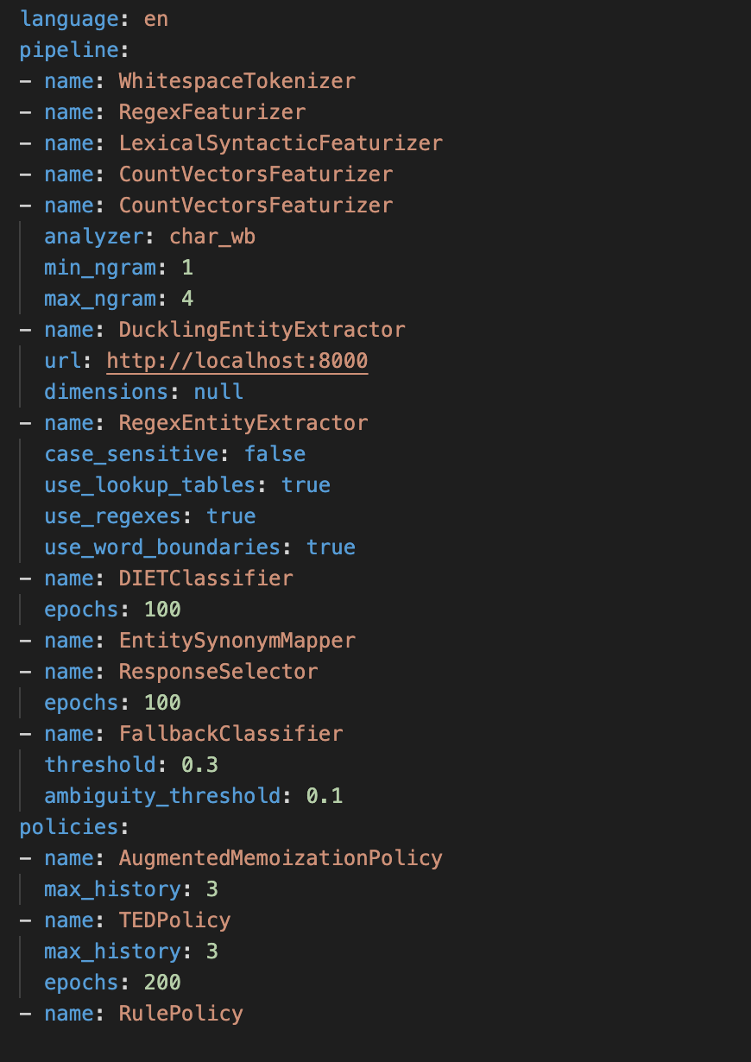
Model
Description

Slide 24
Evaluation

Slide 25
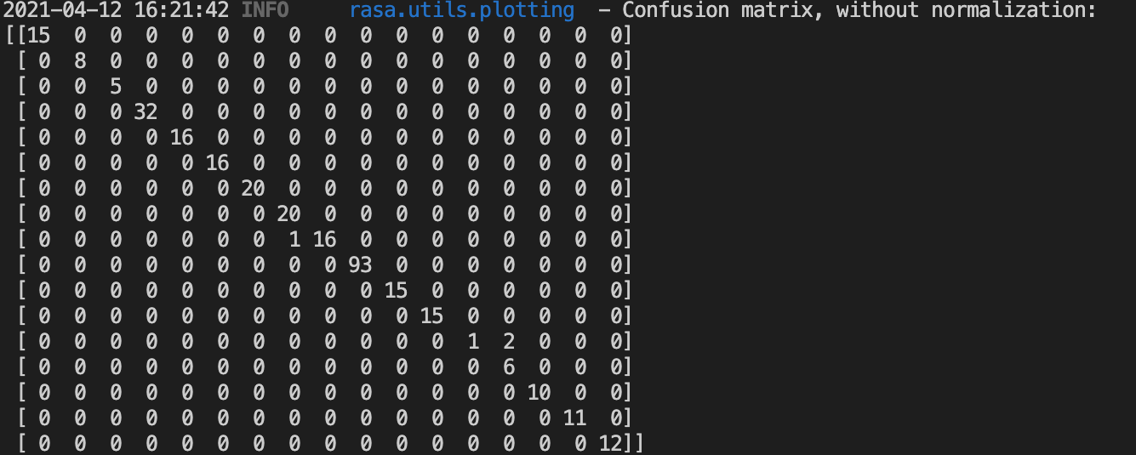
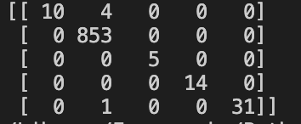
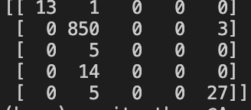
Confusion Matrix

Slide 26
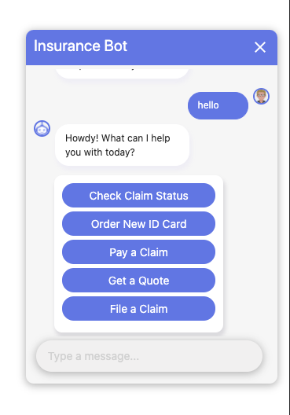
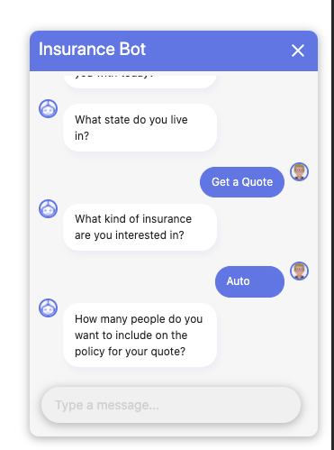
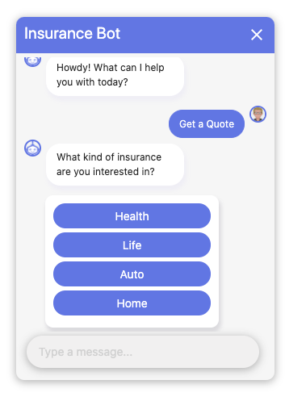
Chatbot Insights!

Slide 27
Demo

Slide 28
References
https://www.spaceo.ca/ai-chatbot-development-using-rasa-reasons/
https://www.youtube.com/watch?v=Z9zTJS6cWiQ&list=PLIRnO_sdVuEevLMSy7bE-Jaqyf1MK_wtr&index=4
https://www.slideshare.net/TarangRai1/chatbots-in-insurance-your-friendly-virtual-agents?qid=c840c65a-5cf2-4f5f-8409-f217f0f3b249&v=&b=&from_search=14
https://www.slideshare.net/insureedge/employ-the-insurance-chatbot-for-effective-changes-in-the-insurance-sector?qid=c840c65a-5cf2-4f5f-8409-f217f0f3b249&v=&b=&from_search=8
https://marutitech.com/insurance-chatbots/

